Slide 1







UNION COUNTY TEAMS CS
HIGH SCHOOL/COLLEGE LEADERSHIP ACADEMY
Mission Statement
The Union County TEAMS Charter School is a small learning community where all students will achieve high academic standards by using the “built environment” as a learning laboratory. Students, in grades K-12 will gain the tools necessary for successful high school experiences, post-secondary education and the world of work. They will interact with professionals in the community and manifest by their experiential learning –
“We Are Community Builders…Aiming High and Achieving Greatness”
STATE OF THE SCHOOL ‘23
EXECUTIVE DIRECTOR
Sheila L. Thorpe, BA, MA, MTS
NSDC AND IEL FELLOW

Slide 2
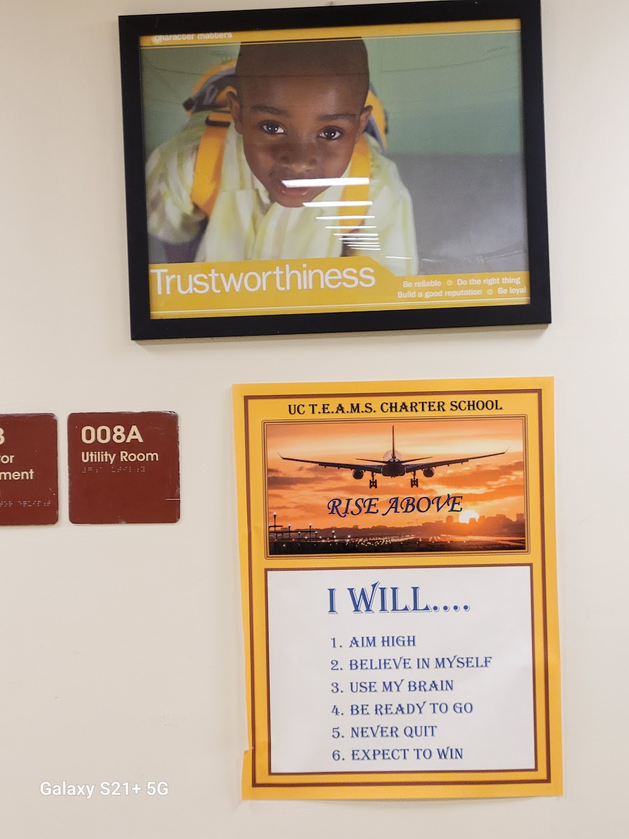

Agenda
GREETINGS
STAFF INTRODUCTIONS
WE ARE UC TEAMS CS – HS/CLA - DEMO
GOALS AND OBJECTIVES ‘23
GOALS AND OBJECTIVES ‘24

Slide 3


Slide 4
UCT A SMALL LEARNING COMMUNITY …. 330 SCHOLARS … LEADERS
UC TEAMS CS | DEMOGRAPHICS
SWD/504/ELL | 12%
FREE/REDUCED POP | 80%
AFRICAN AMERICAN/BLACK | 57%
HISPANIC/LATINO | 40%
OTHER ETHNIC GRPS | 3%
DISTRICTS SERVED | 12
DISTRICT HIGHLIGHTS | DIGITAL CURRICULUM, VOL, SEL, MCC BRIDGE, PEER LEADERSHIP, LRS
EXTENDED DAY PROGRAMS | HOMEWORK CLUB, STAR, RISE,
EXTRA-CURRICULAR | CLUB WEDNESDAYS, NHS, COED BASKETBALL LEAGUE
PARENT COMMUNITY | PTC, PCC
SEL – Social Emotional Learning
VOL – Virtual Online Learning
STAR – Scholars Targeted for Academic Rigor
RISE – Reach, Inspire, Support, Enrich
PTC – Parent Teacher Conferences
PCC – Parent Community Conferences

Slide 5
Goal #1 Academic | The UC TEAMS Charter School will demonstrate improved academic performance in Statewide Assessments as indicated below: NJSLA ELA and Math for grades 3 – 10 NJSLA in Science for grades 5, 8, and 9
Measure | 10-25% Growth in percentage of students demonstrating proficiency in Statewide assessments by June 2023.
Target | 75% or better of all students, grades 3 – 11, will be proficient or better on the ELA Statewide Assessments. 65% or better of all students, grades 3 – 11, will be proficient or better on the Math Statewide Assessments. 70% or better of all students, grades 5,8,9, will be proficient or better on the Science Statewide Assessment.
Actual Outcome | Growth was demonstrated in three (3) ELA classes and three (3) MATH classes ELA: Grade 5 = 42% ; Grade 7 = 10% ; Grade 9 = 10% MATH: Grade 3 = 28% ; Grade 4 = 45% ; Grade 8 = 47% However, The target was NOT MET

Slide 6
Goal #1 A Academic Performance: | The UC TEAMS Charter School will demonstrate improved academic performance in District Assessments, i.e., Link-It Benchmarks( exclude grade 12), or DRAs (K – 5), or unit assessments in Math and ELA, (Savvas RealizeK-12 Curriculum) for grades K – 11.
Measure | 10 – 15% Growth in percentage of students demonstrating proficiency in school-wide assessments by June 2023.
Target | 75% or better of all students will be proficient or better on all District Assessments from pre to post.
Actual Outcome | There was 10 – 82% growth in six of twelve grades in ELA and 10 – 39% growth in nine of eleven grades in Math. 50% and 51% all students were proficient on district assessment , LINK-IT, in ELA and MATH respectively Target was PARTIALLY MET

Slide 7
Goal #2 Dual High School College Performance: | The UC TEAMS Charter School will provide all eligible students in the High School/College Leadership Academy an opportunity to participate in the dual high school/college Bridge Program off site at Middlesex County College.
Measure | 5% Growth in percentage of courses passed and taken on the college campus by June 2023.
Target | 85% of all eligible Juniors and Seniors will be enrolled in the dual high school/college Bridge Programs. 85% or better of students taking courses in the Bridge Program will pass all courses taken in both semesters
Actual Outcome | 27 students were eligible to take college courses 2022-23. A total of 83 courses were taken and 94%of all classes received passing grades. Target was MET

Slide 8
Goal #3 High School Graduation: | The UC TEAMS Charter School will provide opportunities for students in grades 9 – 12 to successfully meet the high school graduation requirements as outlined by the district in accordance with state guidelines.
Measure | Maintain 90 - 100 percent high school graduation. Maintain 100 percent of a minimum of two acceptances to a two year or four-year college/university program and/or trade certificated program by June 2023.
Target | 90 - 100% graduation rate. 90 - 100% of all seniors will demonstrate acceptances mentioned above.
Actual Outcome | Twenty-seven seniors met graduation requirements of completing school and state requirements for the same. Target was MET.

Slide 9
Goal #4 Pathway to | The High School/College Leadership Academy will continue to increase graduation requirements via PSAT/SAT and or NJSLA standardized assessment. (9-11)
Measure | 10 – 15% growth in the number of students graduating through the pathway of PSAT /SAT and or NJSLA.
Target | 65% or better of all seniors will use the PSAT/SAT/NJSLA as the pathway to meet assessment standards in either ELA or Math for graduation by June 2023. (NJSLA - No Longer Applies)
Actual Outcome | 50% of all Seniors met graduation requirement via SAT 33% met graduation requirement via Accuplacer, and 15% met graduation via ASVAB 2% (SWD) met graduation requirements via improved Accuplacer score over time. The Target was MET

Slide 10

SMART GOALS 2023-2024
GOAL #1 – ACADEMIC PERFORMANCE DISTRICT
GOAL #2 – ACADEMIC PERFORMANCE STATEWIDE
GOAL #3 – STEM AND BUILT ENVIRONMENT
EXTENDED DAY PROGRAM
GOAL #4 - DUAL HIGH/SCHOOL COLLEGE (9 -12)
ACCELERATED PROGRAM
GOAL #5 – HIGH SCHOOL GRADUATION
GOAL #6 – PATHWAY TO GRADUATION
MEASURES AND TARGETS TBD

Slide 11

The way to get started is to quit talking and begin doing.
Walt Disney

Slide 12


Thank you
Sheila L. Thorpe
sthorpe@ucteams
www.ucteams.org

